Slide 1
Autism Spectrum Disorder and Law Enforcement
Presented by :
John Bassi
Investigator, Pittsfield Police Department

Slide 2
Today’s Goals
Learn some basic information about individuals with autism.
Learn some basic tips for interactions with individuals with autism.
Become familiar with local resources.

Slide 3
Why am I teaching this??
“Autistic boy held on ground by Officers.”
2017. Arizona (NBC.com)
“Teen with autism struck,killed by car.”
2017 Kentucky
(WLWT5)
“Shalom Larson, an 8- year-old Louisville boy who loved hugging people he just met, wandered from a relative’s home and drowned.”
2017
Kentucky
(lex18.com)
“Arrest of autistic man prompts call for police training.” 2019
South Carolina
(wyff4.com)

Slide 4
Autism Defined
Autism Spectrum Disorder (ASD) is a developmental disability that can cause significant social, communication, and behavioral challenges.

Slide 5
Types of Autism
Level 1-requiring support: Individuals with Level 1 ASD are often able to live independently, with supports in place. They exhibit some deficits in social communication that can make it difficult to initiate social interactions and appropriately respond to social cues. Challenging behaviors include inflexibility, difficulty with transitions, and problems with organization and planning.
Level 2- requiring substantial support: Individuals with Level 2 autism have noticeable deficits in verbal and nonverbal communication skills as well as impaired social skills, even with supports in place. Challenging behaviors include inflexibility, difficulty coping with change, restricted or repetitive behaviors, and distress and/or difficulty changing their attention or action.
Level 3- requiring very substantial support: Someone with Level 3 ASD exhibits severe deficits in verbal and nonverbal communication, and may be entirely nonverbal. They initiate limited social interactions and responses to others, and they only respond to very direct social approaches. Challenging behaviors include inflexible behavior, extreme difficulty with change, great distress and difficulty changing focus or actions, and restricted or repetitive behaviors that interfere with all aspects of functioning.
https://www.elemy.com/studio/autism-resources/police-interactionsgraph text

Slide 6
Characteristics of ASD
Abilities are uneven
Difficulty paying attention, extra time needed to process information
Difficulty performing upon request
Learn better visually
Transitions or break in routine are extremely difficult

Slide 7
Characteristics of ASD
Remember things mechanically or “machine-like”
Difficulty understanding the desires, intentions and beliefs of others
Motivation and performance can be inconsistent
Difficulty seeing the big picture
Inability to take someone else’s perspective
Boronson, Barbara. (2016) Autism Spectrum Disorder in the Inclusive Classroom. Sholastic Inc., New York

Slide 8
Other Considerations
A Person with Autism May:
Not speak
Appear deaf
Avoid eye contact or look down when speaking
Not respond to their name or verbal commands
Rock, pace, spin or hand-flap (stimming), or repeat phrases
Hold hands over ears due to sound sensitivity
Avoid or resist physical contact
Have unusual fears or obsessions with things like flashing lights, sirens, K-9s
Not answer questions and need time to process questions or demands
Try to run away or hide
Appear to be under the influence
Not properly dressed for the elements
Have the mental capacity of someone much younger

Slide 9
How many of you have little or no contact (personally or professionally) with individuals on the autism spectrum?
How many of you come into personal contact with individuals on the autism spectrum?
How many of you come into professional contact with individuals on the autism spectrum?
How many of you feel confident in your ability to deal with individuals on the autism spectrum?

Slide 10
Why are those on the Autism Spectrum a Police Problem?
People with developmental disabilities are at least 7 times more likely to attract the attention of the police, because their unique communication styles and social characteristics may frighten or disturb some people (Curry K, Posluszny M., Kraska S, 1993). People with ASD sometimes become frightened or over-stimulated and engage in challenging or seemingly offensive behaviors. Most often, police will be called for an autistic subject due to their unusual behavior, rather than dangerous or criminal activity.

Slide 12
Autism is a spectrum disorder and there are a variety of individuals, some you will never encounter!
Autistic people should receive more equal treatment.
People should have a greater understanding that those with autism may have different needs and ways of coping.
Society should allow for autistic differences and create more equal opportunities.
Society shouldn’t try to make autistic people ‘fit’ into society, but have society accommodate for them.

Slide 13
Fast Facts
Graphic Courtesy: of:

Slide 14
ASD and Missing Person
If Person With Autism is Missing...
Treat each case as critical. Those with autism can have an impaired sense of danger and often go straight to water or traffic.
Ask the caregiver if the person wears a personal tracking device, if so, immediately initiate tracking measures.
Search Water First! Even if the child or adult is said to dislike water, search any type of nearby water, including waste water.
Ask about other dangers that the person may be attracted to; busy roads/highways/construction sites, etc. and immediately dispatch personnel to secure those areas.
Ask about individual’s likes that may assist in search efforts – Will they be drawn to certain music, favorite characters, fire trucks, mom’s voice, etc.
Ask about individual’s dislikes and fears or sensory issues that may hinder search efforts. (Dogs, Sirens, Aircraft, Lights, Shouting.)
Ask if the individual will respond to his/her name when called.
Implement Reverse 9-1-1 (Visit achildismissing.org for details.)
Issue an Endangered Missing Alert.
Source: National Autism Association

Slide 15
Autism and Wandering
Source: National Autism Association
49% of children with ASD attempt to elope from a safe environment, a rate nearly four times higher than their unaffected siblings.

Slide 16
Communication Strategies
Getting and Keeping their Attention
Always use their name at the beginning so that they know you are talking to them.
Make sure they are paying attention before you ask a question or give an instruction. The signs that someone is paying attention will be different for different people.
Use their hobbies and interests, or the activity they are currently doing, to engage them.

Slide 17
Communication Strategies
Processing Information
Say less and say it slowly.
Use specific key words, repeating and stressing them.
Pause between words and phrases to give the person time to process what you’ve said, and to give them a chance to think of a response. Don’t ask too many questions.
Use less non-verbal communication (prolonged eye contact, facial expressions, gestures, body language).
Use visual supports (Communication boards, Ipad, symbols, timetables, Social Stories), if appropriate.
Be aware of the environment (noisy/crowded) that you are in. Sensory differences may be affecting how much someone can process.

Slide 18
Communication Strategies
Avoiding Open-Ended Questions
Keep questions short.
Ask only the most necessary questions.
Structure your questions, Ex.- you could offer options or choices.
Be specific. For example, ask “Did you enjoy your lunch?” and “Do you enjoy playing your Playstation?” rather than “How was your day?”.

Slide 19
Communication Strategies
If appropriate, give autistic people a visual help card to use to ask for help.
Keep it Simple!!

Slide 20
Communication Strategies
Reactions to “No”
Try using a different word or symbol.
Autistic people may be confused about why you said no. If it’s an activity that they can do later on that day or week, try showing this in a timetable.
'No' is often used when someone is putting themselves or others in danger. If it’s a safety issue, look at ways of explaining danger and safety.
If you are saying 'no' because someone is behaving inappropriately, you may want to change your reaction to their behavior. Try not to shout or give too much attention, a calm reaction may help to decrease this behavior in time.
Set clear boundaries and explain why and where it is acceptable and not acceptable to behave in certain ways.

Slide 21
Good advice from a fellow police officer...
“Persons with brain-based disorders are more likely to have run-ins with the police than others, but they are far less likely to commit a crime. When they get arrested or when an encounter becomes violent between an officer and a subject with autism or other brain-based disorder, it’s often because neither party knew how to communicate with the other.“
From the article, Police and autism: New stats may forecast more contact with ASD subjects Doug Wyllie, PoliceOne.com, April 2012

Slide 22
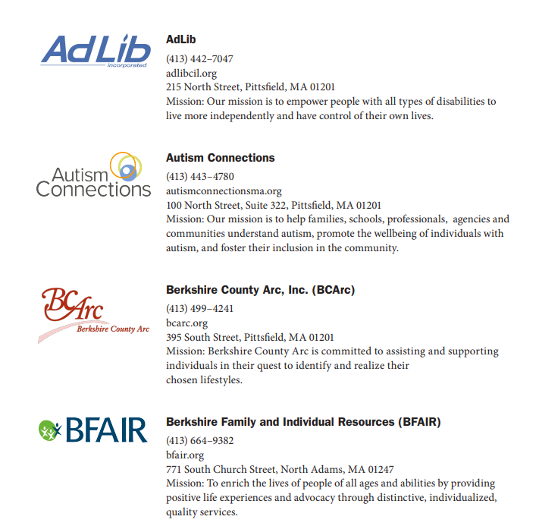
Resources

Slide 23
Remember, Individuals with Autism just want to be accepted!!!
PHS Graduate 2022
PHS Unifed Basketball 2023
PHS Prom 2022
Jake and his fan club

